Slide 1
DigiTec Projekt 2. Semester
Camel Up
9th Sprint
20.06.2025
Emanuel, Konrad, Wladimir, Beqa, Marcel and Thies
Camel Up
Camel Up

Slide 2
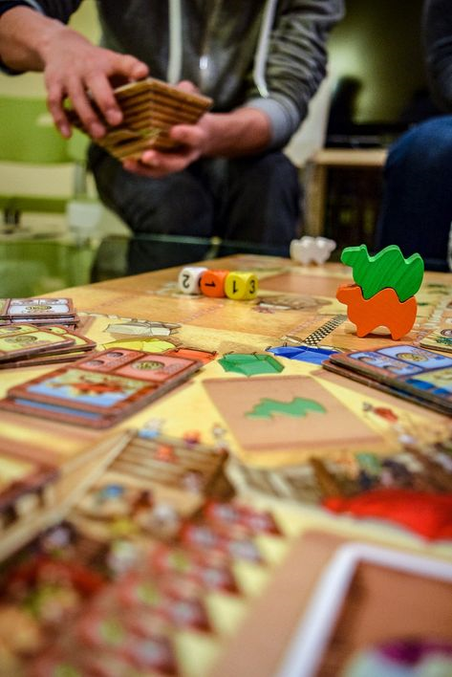
Overview: Game and Goal – Camel Up
Goal:
Create a web application from Camel Up
Emanuel, Konrad, Wladimir, Beqa, Marcel and Thies
Camel Up

Slide 3
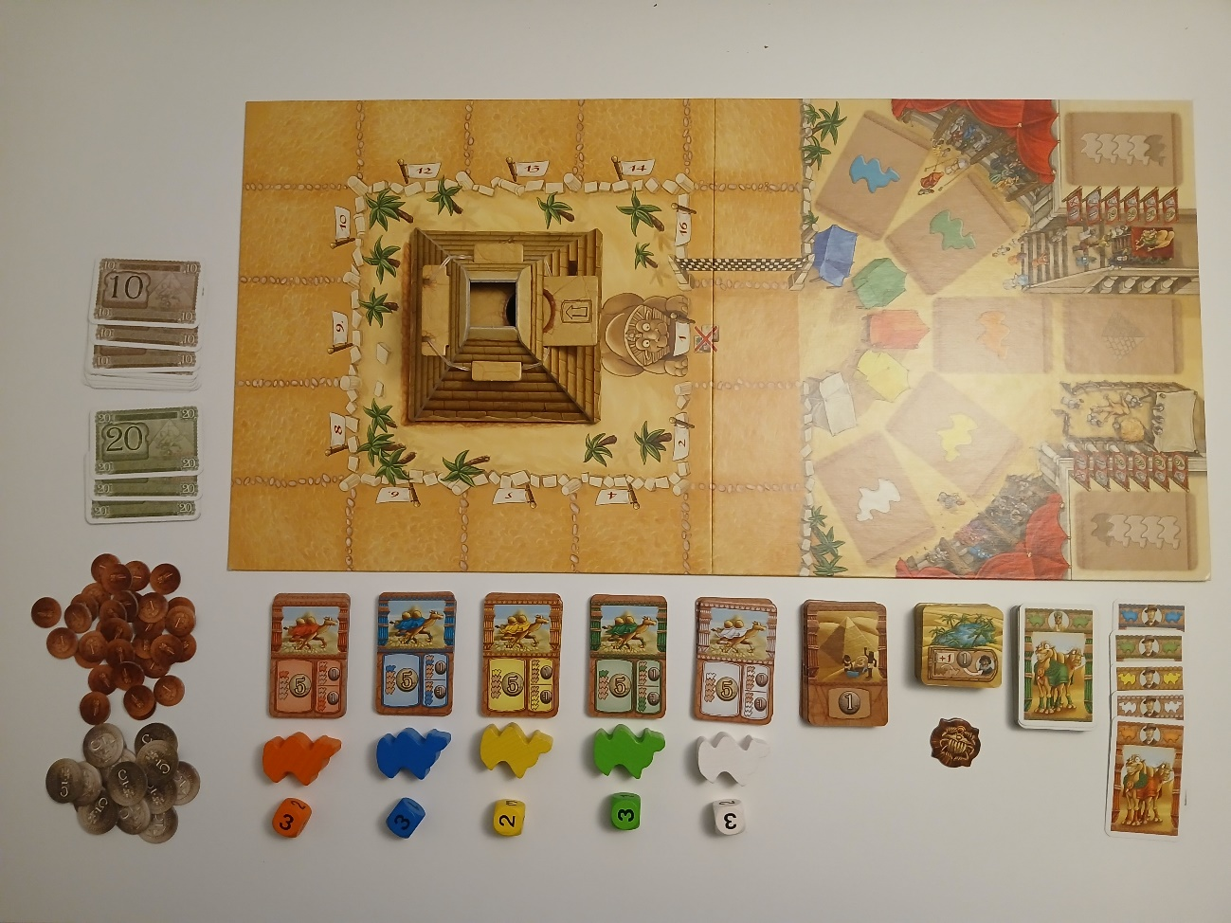
Overview: Game and Goal – Camel Up
Goal:
Create a web application from Camel Up
Emanuel, Konrad, Wladimir, Beqa, Marcel and Thies
Camel Up

Slide 4
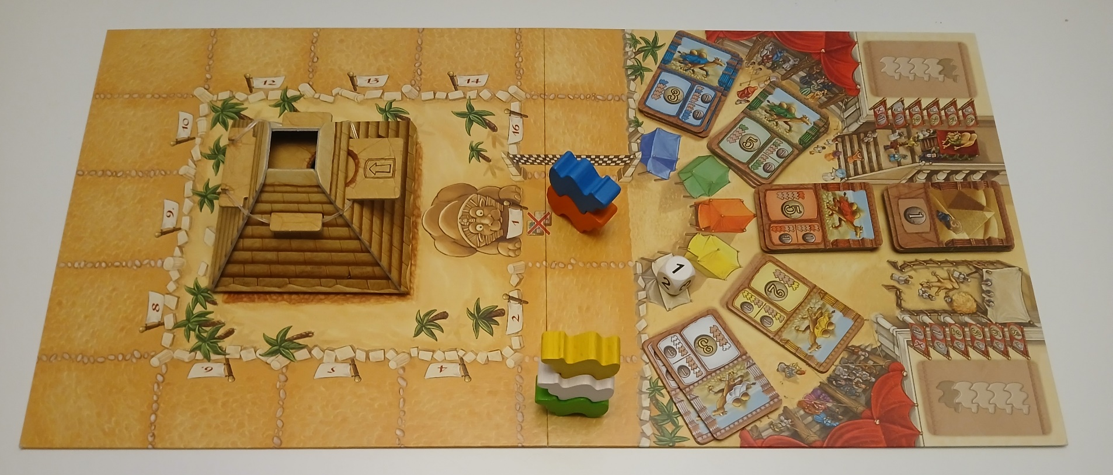
Overview: Game and Goal – Camel Up
Emanuel, Konrad, Wladimir, Beqa, Marcel and Thies
Camel Up

Slide 5
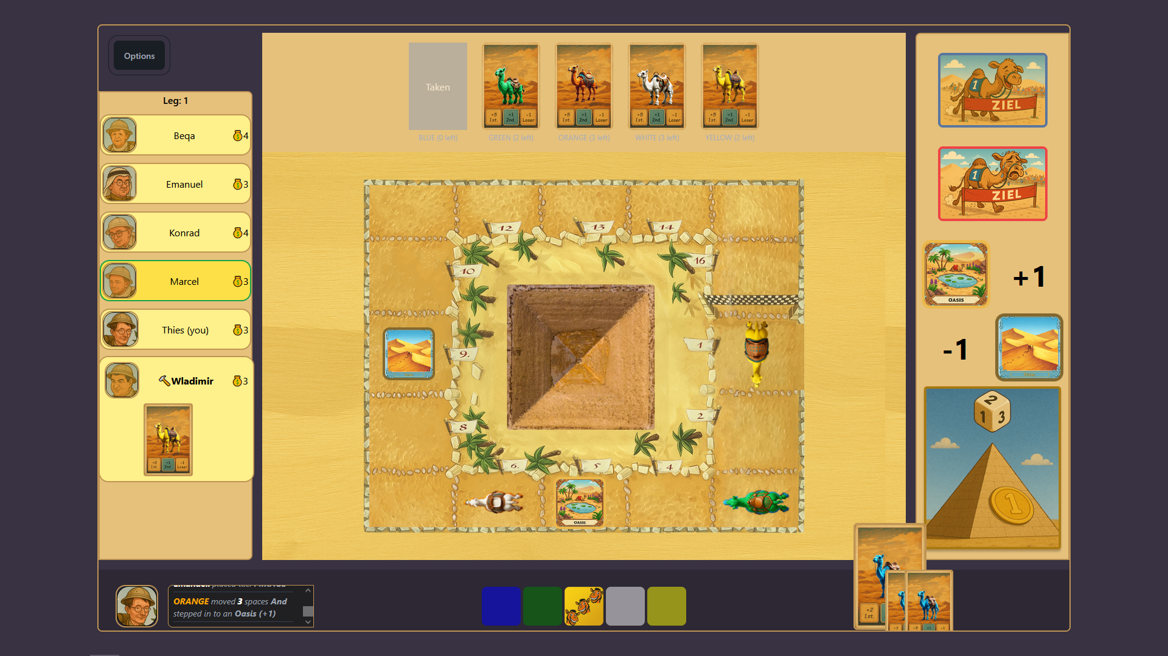

UI Mockup
Emanuel, Konrad, Wladimir, Beqa, Marcel and Thies
Camel Up

Slide 6
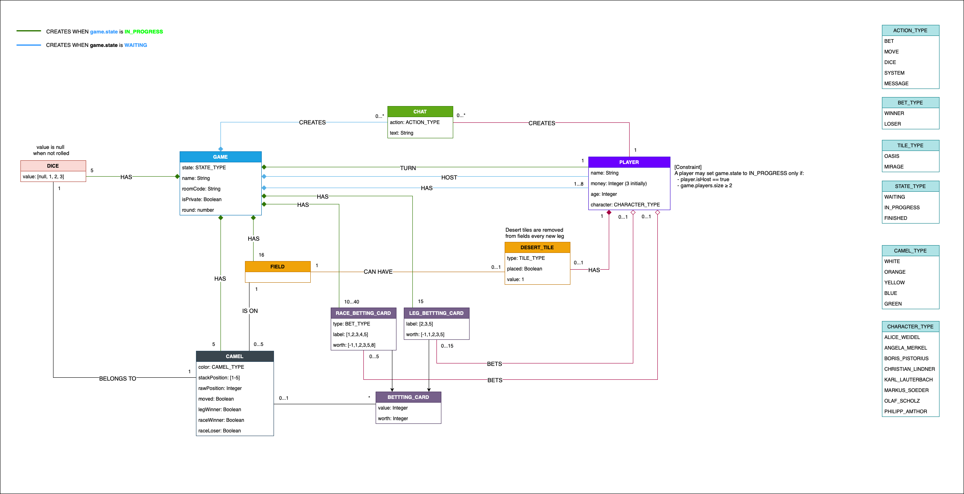
Domain model
Emanuel, Konrad, Wladimir, Beqa, Marcel and Thies
Camel Up

Slide 7
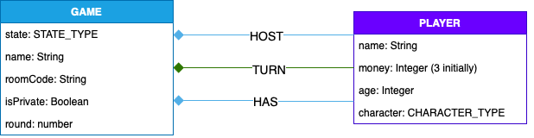
Domain model
Game and Player
Emanuel, Konrad, Wladimir, Beqa, Marcel and Thies
Camel Up

Slide 8
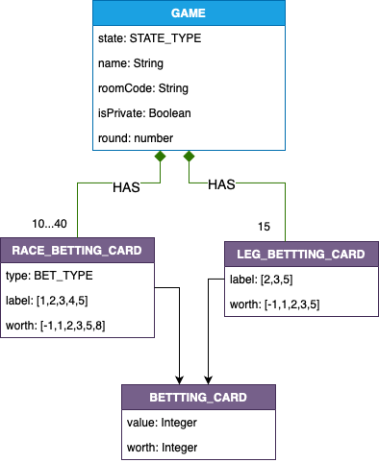
Domain model
Betting Cards
Emanuel, Konrad, Wladimir, Beqa, Marcel and Thies
Camel Up

Slide 9
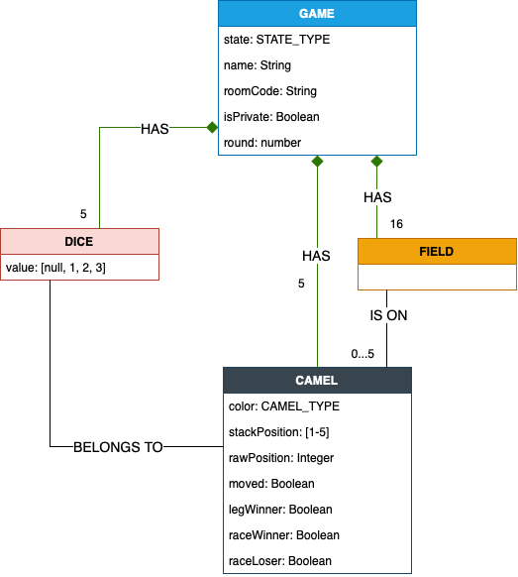
Domain model
Camels
Emanuel, Konrad, Wladimir, Beqa, Marcel and Thies
Camel Up

Slide 10
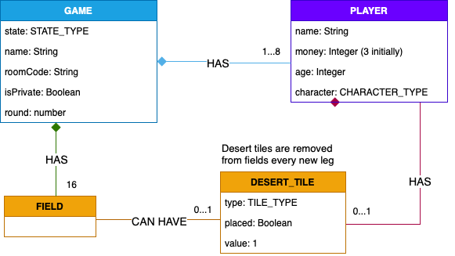
Domain model
Desert Tiles
Emanuel, Konrad, Wladimir, Beqa, Marcel and Thies
Camel Up

Slide 11
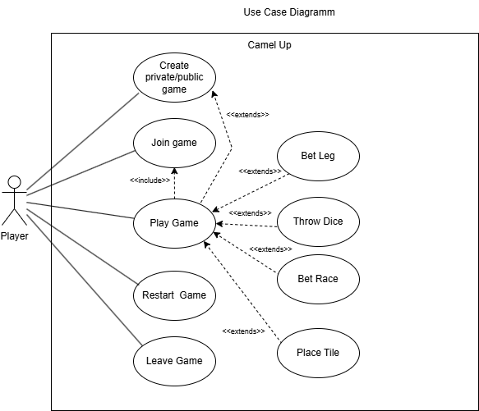
Use Case Diagramm
Epics
Create private/public game
Join Game
Play Game
Restart game
Leave Game
Emanuel, Konrad, Wladimir, Beqa, Marcel and Thies
Camel Up

Slide 12
1) Epic: Create a public or private game The system should allow the player to create a public or a private game.
As a player, I want to create a private game so I can play with my friends.
Acceptance Criteria :
User should be able to create game that is not visible.
Private game should have its own unique code.
Emanuel, Konrad, Wladimir, Beqa, Marcel and Thies
Camel Up

Slide 13
1) Epic: Create a public or private game The System should allow the player to create a public or a private game.
2. As a player I want to create a public game, so I can play the game with random players.
Acceptance Criteria:
User should be able to create game room that is avialable for everyone.
Emanuel, Konrad, Wladimir, Beqa, Marcel and Thies
Camel Up

Slide 14
2) Epic: Join game The System should allow a player to join a private or public game
1. As a user I want to be able to join the game and be updated about it is status
Acceptance Criteria:
Joining the game registers the playe to the the game.
The player will be updated about the game state, when registered to the game
Emanuel, Konrad, Wladimir, Beqa, Marcel and Thies
Camel Up

Slide 15
3) Epic: Play game The System should allow an active player to do the player actions.
1. As an active player in the game I want to be able to roll the dice that moves a camel.
Acceptance Criteria:
After rolling the dice the player get an agyption pound
After rolling the dice the camel gets moved by a random value [1-3].
Emanuel, Konrad, Wladimir, Beqa, Marcel and Thies
Camel Up

Slide 16
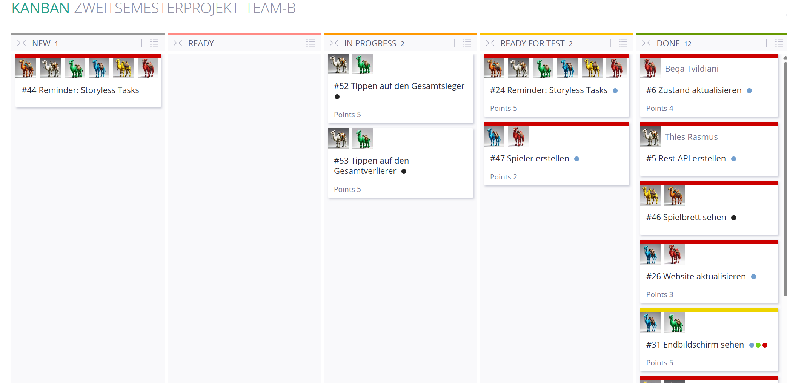
workflow
Emanuel, Konrad, Wladimir, Beqa, Marcel and Thies
Camel Up

Slide 17
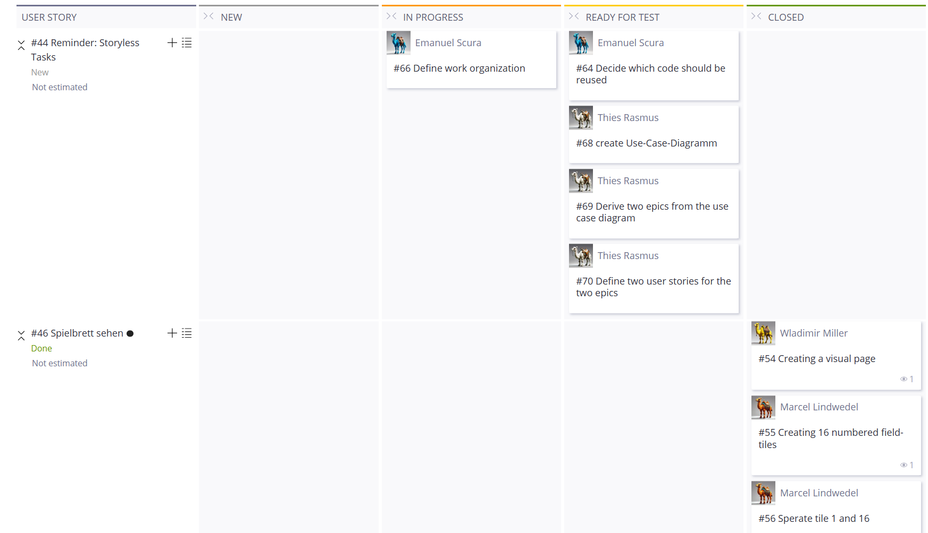
Workflow
Emanuel, Konrad, Wladimir, Beqa, Marcel and Thies
Camel Up

Slide 18
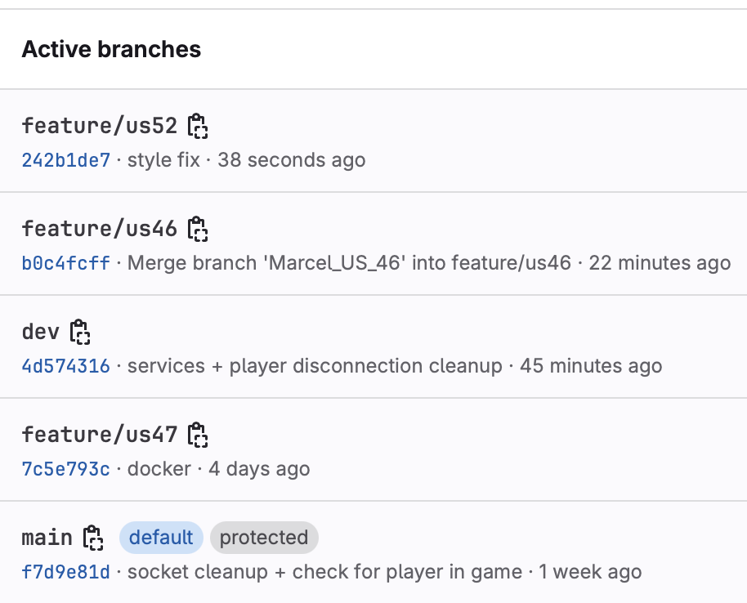
Workflow
main – always production-ready
dev – integrated development (current epic)
feature/xyz – specific user story
fix/xyz – hotfix or bugfix branches
Emanuel, Konrad, Wladimir, Beqa, Marcel and Thies
Camel Up

Slide 19


Client 1
Context view:
technical overview
Client 2
Client 3
Clients x
server
Emanuel, Konrad, Wladimir, Beqa, Marcel and Thies
Camel Up

Slide 20
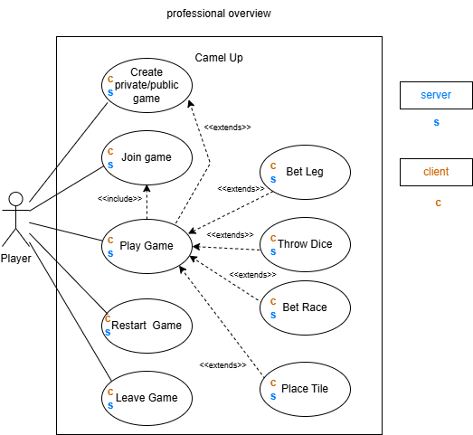
Context view:
professional overview
Emanuel, Konrad, Wladimir, Beqa, Marcel and Thies
Camel Up

Slide 21
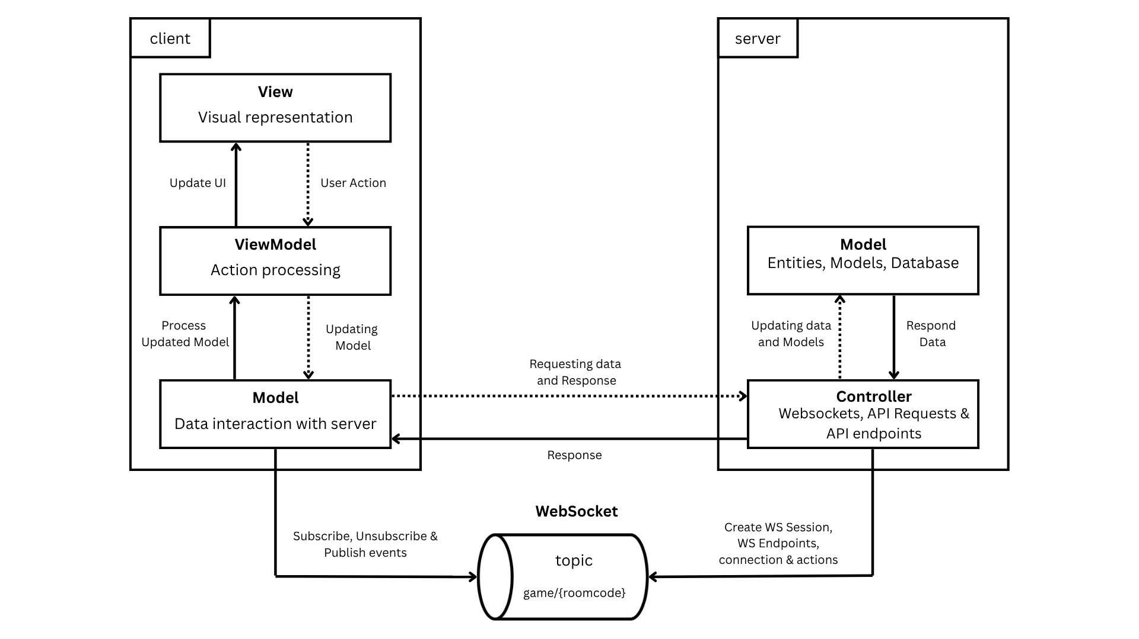
High-Level Architecture
Emanuel, Konrad, Wladimir, Beqa, Marcel and Thies
Camel Up

Slide 22
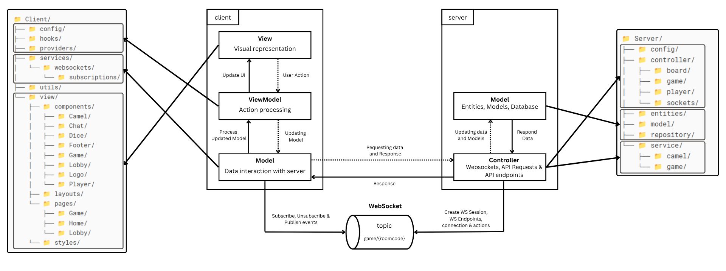
High-Level Architecture
Emanuel, Konrad, Wladimir, Beqa, Marcel and Thies
Camel Up

Slide 23
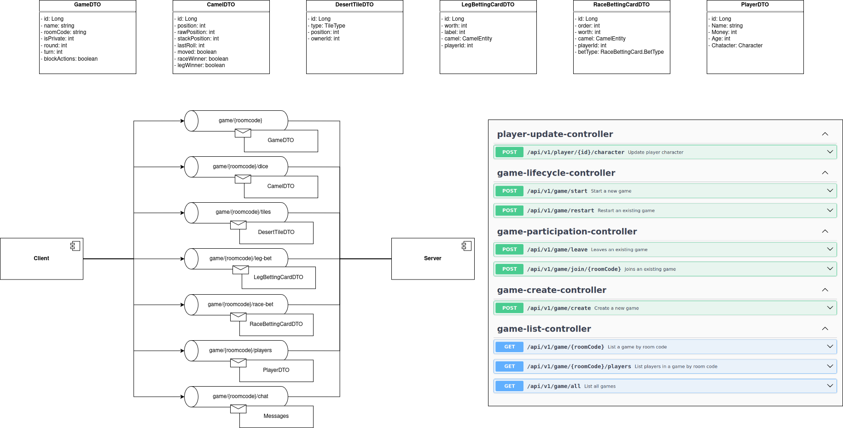
Structural View: top-level
Websockets
Rest-API
Emanuel, Konrad, Wladimir, Beqa, Marcel and Thies
Camel Up

Slide 24
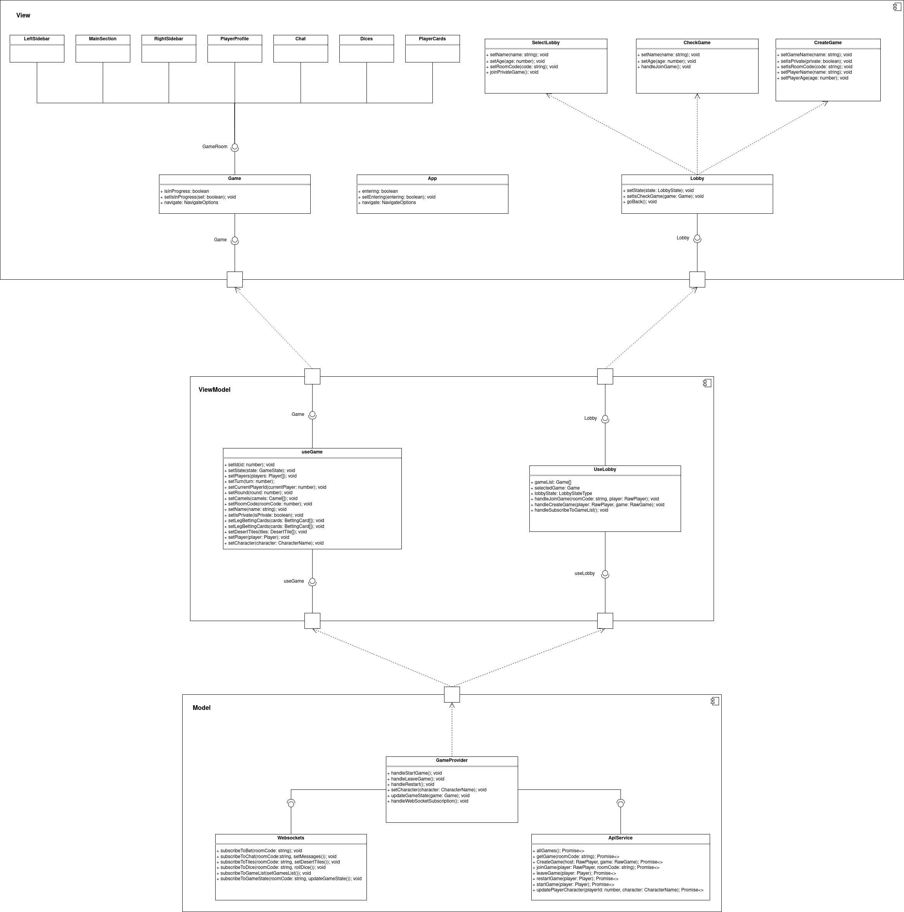
Structural View: Client
Emanuel, Konrad, Wladimir, Beqa, Marcel and Thies
Camel Up

Slide 25
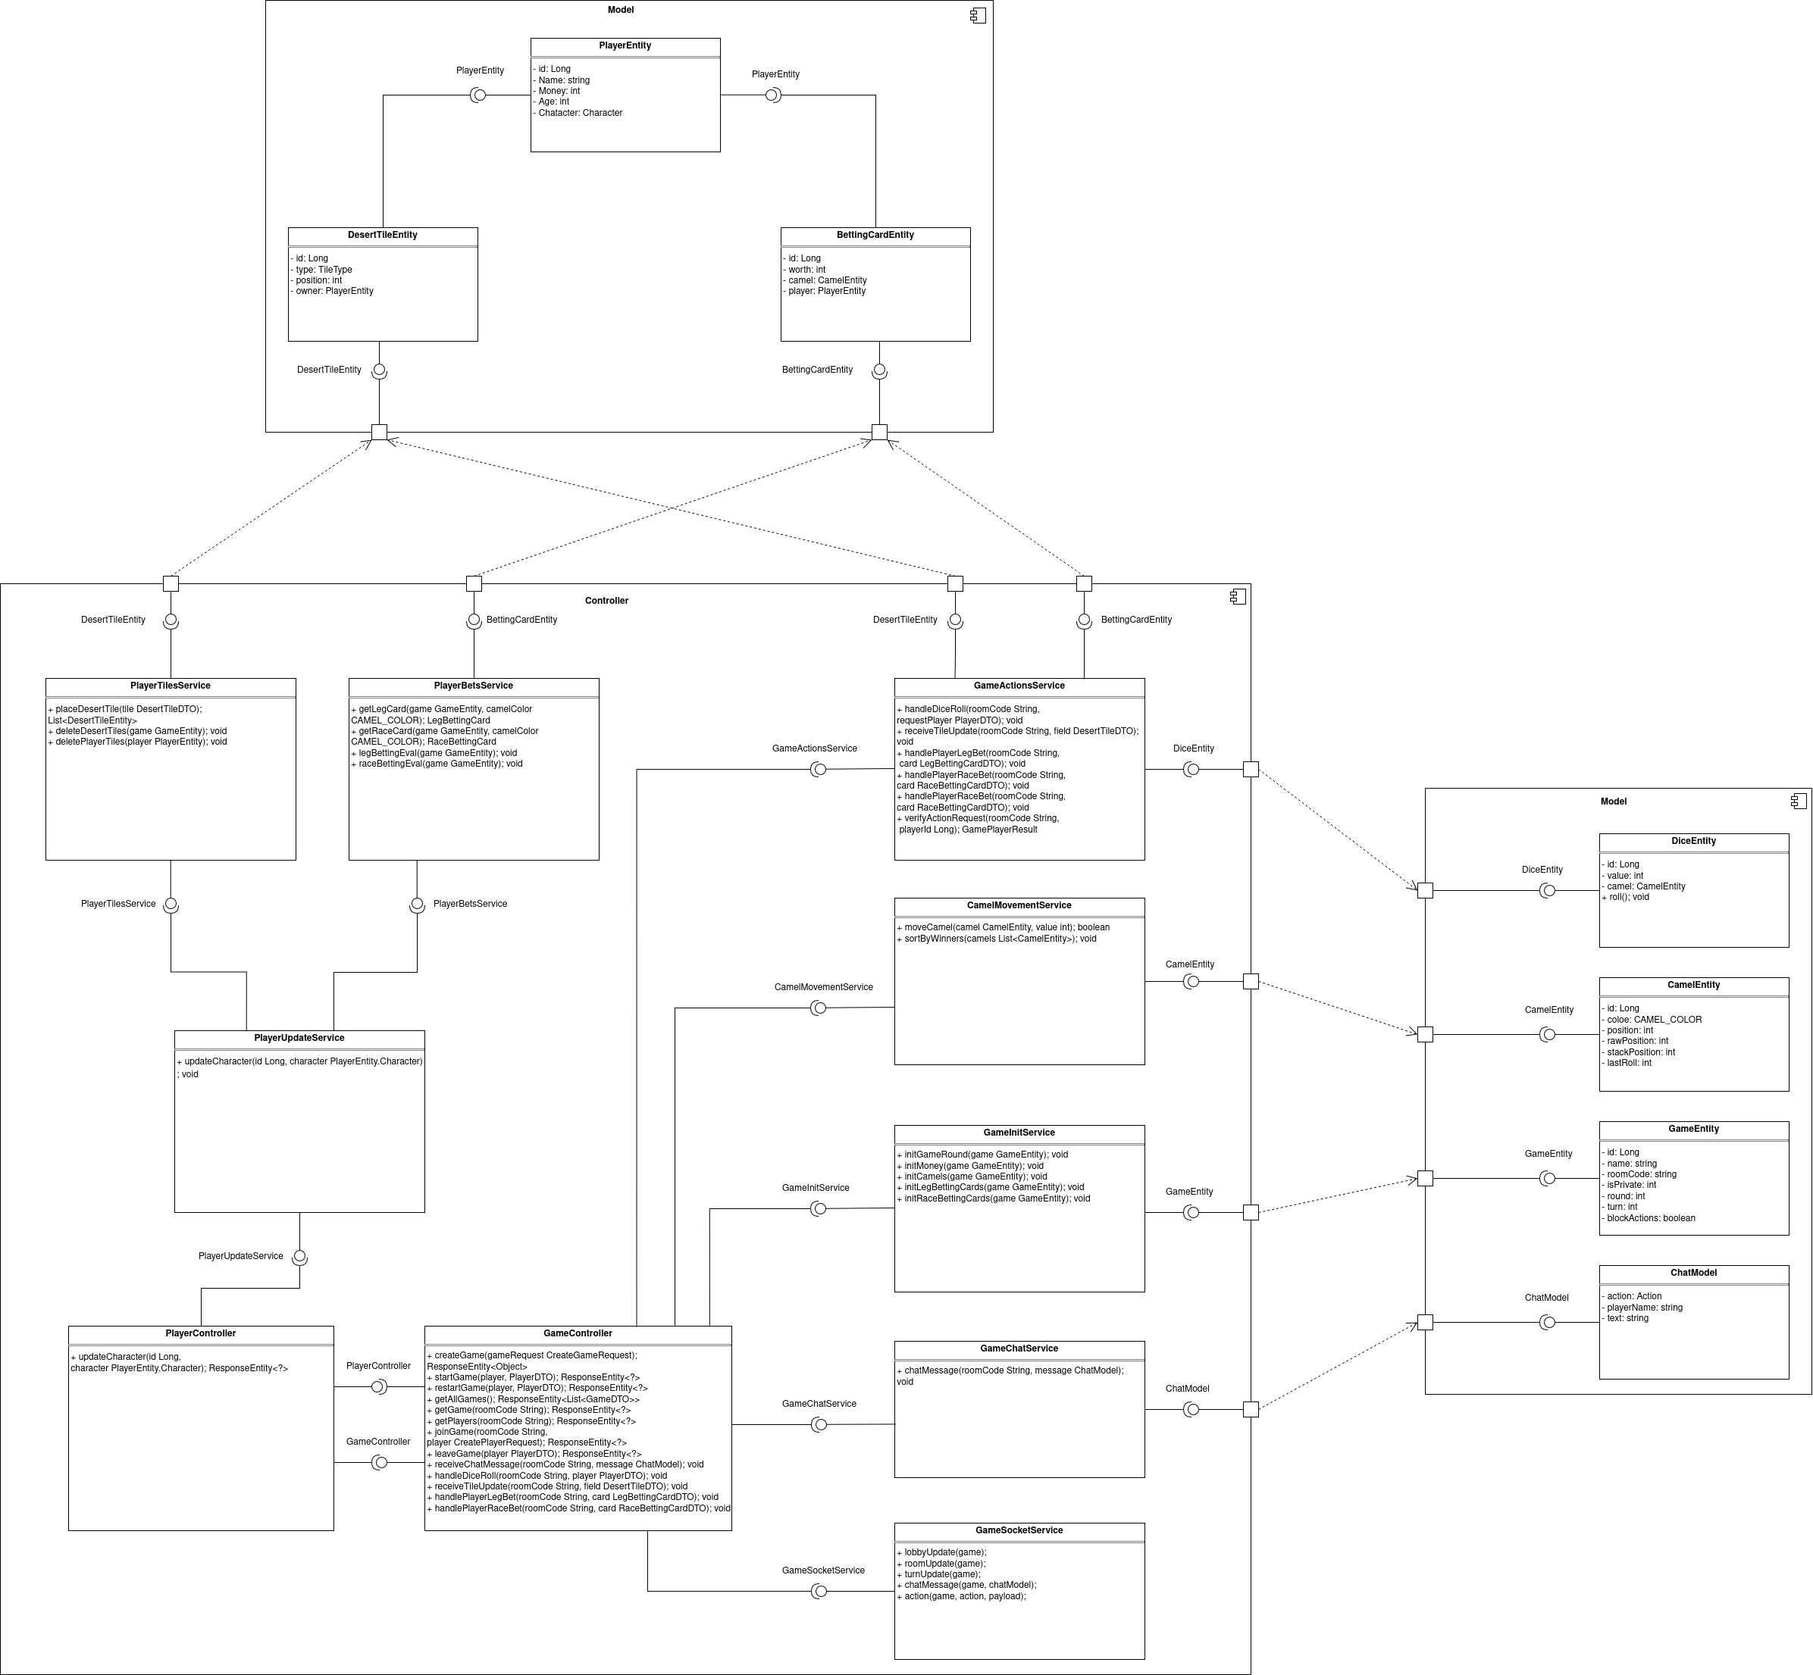
Structural View: Server
Emanuel, Konrad, Wladimir, Beqa, Marcel and Thies
Camel Up

Slide 26
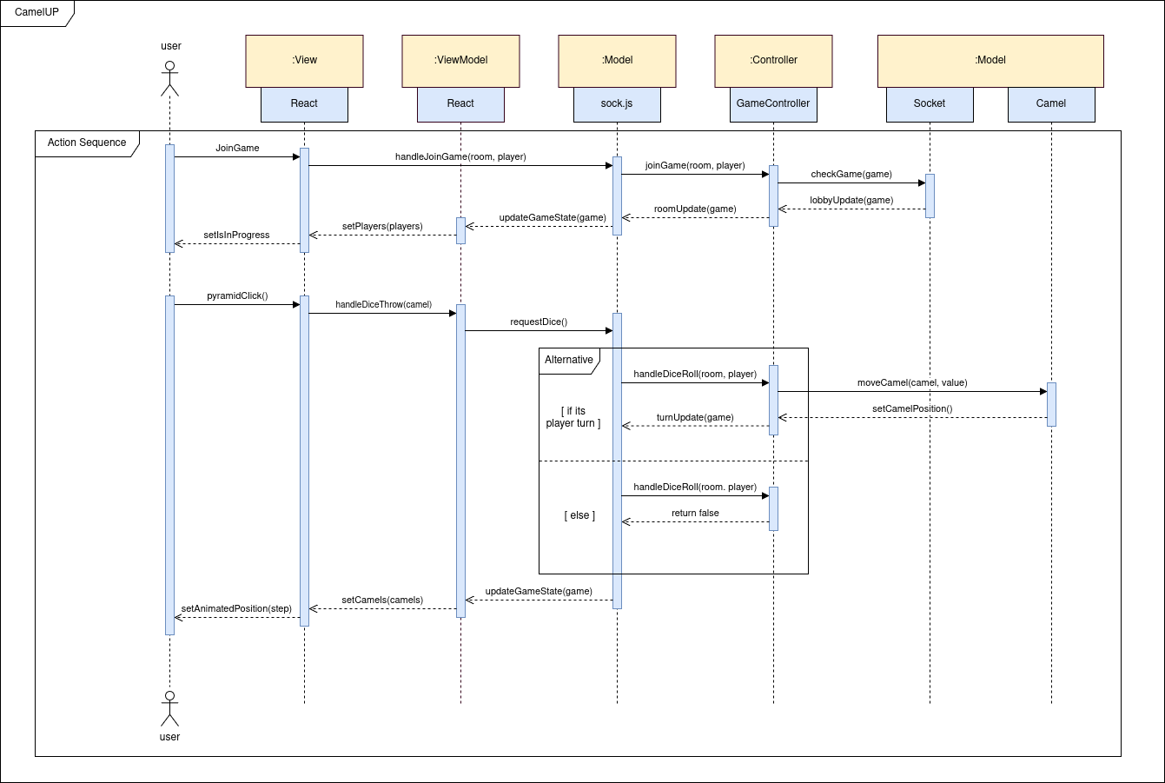
Behavioral View
Userstory 1: As a user I want to be able to join the game and be updated about it’s status
Userstory 2: As an active player in the game I want to be able to roll the dice that moves a camel.
Emanuel, Konrad, Wladimir, Beqa, Marcel and Thies
Camel Up

Slide 27
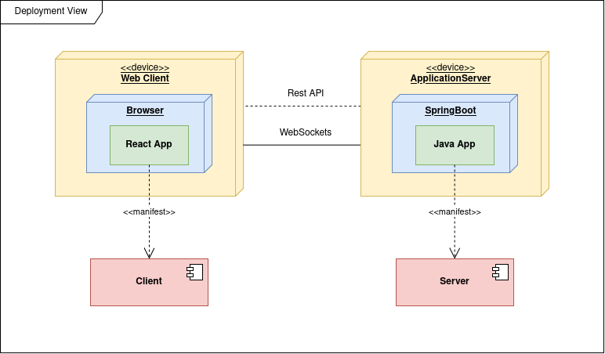
Deployment View:
Emanuel, Konrad, Wladimir, Beqa, Marcel and Thies
Camel Up

Slide 28
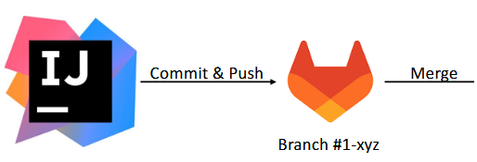


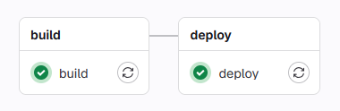
Continuous Integration
Commit & Push
Merge
main
Branch feature/us000
Emanuel, Konrad, Wladimir, Beqa, Marcel and Thies
Camel Up

Slide 29
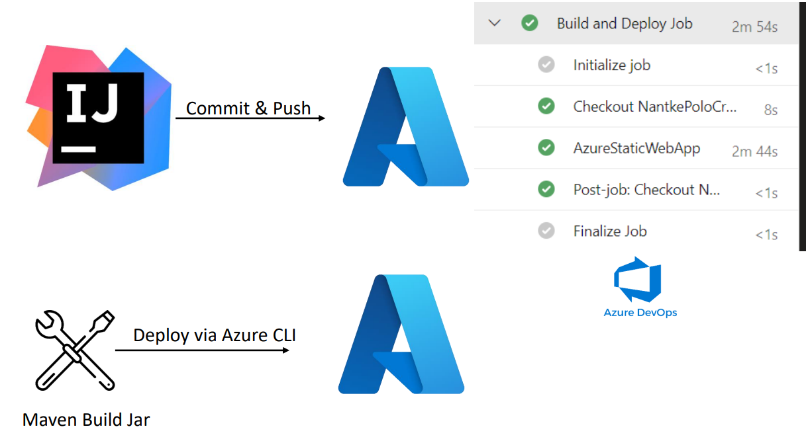
Continuous Deployment
Commit & Push
Deploy via Azure CLI
Mave Builder Jar
Emanuel, Konrad, Wladimir, Beqa, Marcel and Thies
Camel Up

Slide 30
Fortschritt
DEMO
Emanuel, Konrad, Wladimir, Beqa, Marcel and Thies
Camel Up

Slide 31
Thank You for your time!
Emanuel, Konrad, Wladimir, Beqa, Marcel and Thies
Emanuel, Konrad, Wladimir, Beqa, Marcel and Thies
Camel Up

